Slide 1

“Language Learning Flashcards”
Sanjivani Rural Education Society’s
Sanjivani College of Engineering, Kopargaon 423 603
(Affiliated to Savitribai Phule Pune University, Pune )
Department of Computer Engineering
Prepared By,
Mr. Dhadge Vedant [UCS23M1034]
Mr. Gayke Prathamesh [UCS23M1044]
Guided By,
Prof. S. S. Gawali

Slide 2
Contents
Sanjivani Rural Education Society’s
Sanjivani College of Engineering, Kopargaon 423 603
(Affiliated to Savitribai Phule Pune University, Pune )
Department of Computer Engineering Research Center
Introduction of project
Functionality of project
Details about Data types used in project
Details about predefine module/libraries used in project
Details about predefined function.
Output of Code.

Slide 3
Sanjivani Rural Education Society’s
Sanjivani College of Engineering, Kopargaon 423 603
(Affiliated to Savitribai Phule Pune University, Pune )
.
Objectives
Make an easy to use flashcards app
Make English accessible to Marathi speakers
Provide a simple way to expand and test vocabulary
Notes:
Welcome to our English Learning Flashcards App! In today's globalized world, English proficiency is more important than ever.
Our app makes learning English easy and enjoyable for Marathi speakers.
Start your journey to English fluency today!

Slide 4
Functionality of Project
Sanjivani Rural Education Society’s
Sanjivani College of Engineering, Kopargaon 423 603
(Affiliated to Savitribai Phule Pune University, Pune )
load_vocabulary: Loads english and marathi words from and external CSV file
display_question: Displays next question to the user and refreshers screen.
get_mcq_options, check_mcq_answer : gets mcq options and check weather user’s selected option is correct or not.
display_score: calculates end score of user based on their choices.

Slide 5
Details about Data types used in project
Sanjivani Rural Education Society’s
Sanjivani College of Engineering, Kopargaon 423 603
(Affiliated to Savitribai Phule Pune University, Pune )
List: used to store english and marathi words.

Slide 6
Details about predefine module/libraries used in project
Sanjivani Rural Education Society’s
Sanjivani College of Engineering, Kopargaon 423 603
(Affiliated to Savitribai Phule Pune University, Pune )
csv: used to import data from csv file.
random: used to get random words from the imported data.
tkinter: used to create GUI.

Slide 7
Details about predefined function
Sanjivani Rural Education Society’s
Sanjivani College of Engineering, Kopargaon 423 603
(Affiliated to Savitribai Phule Pune University, Pune )
open: use to read csv file.
Lable: used to add gui lables.
pack: used to add padding to gui elements.

Slide 8
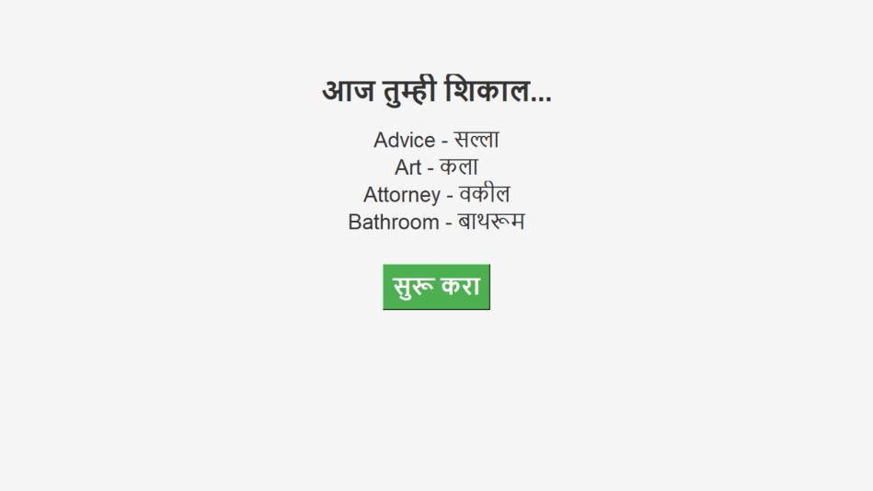
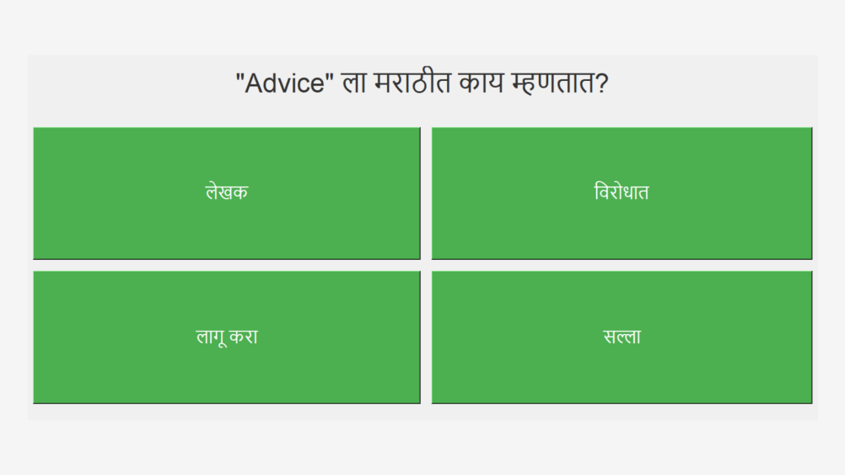
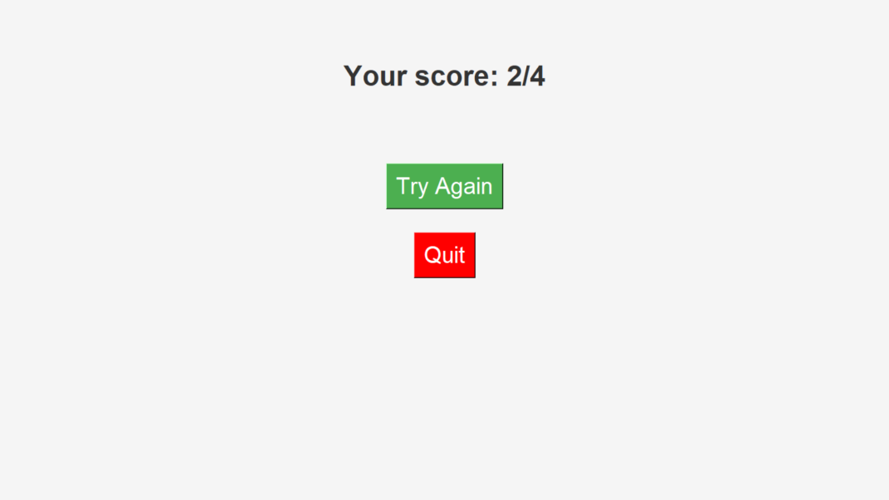
Output
Sanjivani Rural Education Society’s
Sanjivani College of Engineering, Kopargaon 423 603
(Affiliated to Savitribai Phule Pune University, Pune )

Slide 9
Thank You
Sanjivani Rural Education Society’s
Sanjivani College of Engineering, Kopargaon 423 603
(Affiliated to Savitribai Phule Pune University, Pune )

